Slide 1
Lecture 7. Hash Function Applications
CSE 1204 Applied Cryptography
Lectures by Zhaxalykov T.M.

Slide 2
Agenda
Password Hashing: The Problem
Password Hashing Functions
Merkle Trees
Hash Chains and Time-Stamping
Commitment Schemes
Hash-Based Signatures
Conclusion

Slide 3
1. Password Hashing: The Problem
1.1 Why Not Store Passwords in Plaintext?
1.2 Why Not Use SHA-256?
1.3 Requirements for Password Hashing

Slide 4
1. Password Hashing: The Problem
Password storage is one of the most critical security challenges in modern systems. Storing passwords in plaintext is catastrophic; even hashing with general-purpose functions like SHA-256 is inadequate.

Slide 5
1.1 Why Not Store Passwords in Plaintext?
If passwords are stored in plaintext, a database breach immediately compromises all user accounts. Adversaries obtain passwords directly, enabling:
Account takeover on the compromised service
Credential stuffing: trying stolen passwords on other services (users reuse passwords)
Identity theft and further attacks
Historical Example: LinkedIn breach (2012): 117 million passwords stored with SHA-1 and no salt. Result: massive credential stuffing attacks across the internet.

Slide 6
1.2 Why Not Use SHA-256?
General-purpose hash functions like SHA-256 are designed for speed. This is a vulnerability for password hashing because:
Brute Force Speed: Modern GPUs compute billions of SHA-256 hashes per second. An NVIDIA RTX 4090 achieves ~30 billion hashes/second. Adversary can test entire password space rapidly.

Slide 7
Example 1.1: Cracking SHA-256 Hashed Passwords
Password: '123456' (most common password)
SHA-256('123456') = 8d969eef6ecad3c29a3a629280e686cf0c3f5d5a86aff3ca12020c923adc6c92
With 30 billion hashes/second, crack all 8-character lowercase passwords in ~5 seconds
Rainbow Tables: Precomputed tables of hash(password) pairs. Even with salting (adding random data), fast hashes enable rapid online cracking.
Dictionary Attacks: Most users choose weak passwords. Top 10,000 passwords cover ~25% of users. Fast hashes enable testing millions of common passwords quickly

Slide 8
1.3 Requirements for Password Hashing
Definition 1.1 (Password Hashing Function Requirements): A secure password hashing function must be: (1) Slow: Deliberately computationally expensive to slow brute force. (2) Memory-hard: Require significant RAM, preventing GPU/ASIC acceleration. (3) Salt support: Unique salt per password prevents rainbow tables. (4) Configurable cost: Adjustable difficulty as hardware improves. (5) One-way: Cannot reverse hash to obtain password.
Key Insight: For password hashing, slowness is a feature, not a bug. We want legitimate authentication to take ~0.1-1 second, while brute force takes millennia.
Определение 1.1 (Требования к функции хэширования паролей): Безопасная функция хэширования паролей должна быть: (1) медленной: намеренно требует больших вычислительных затрат, чтобы замедлить использование грубой силы. (2) Требует большого объема оперативной памяти, что препятствует ускорению на GPU/ASIC. (3) Поддержка соли: уникальная соль для каждого пароля предотвращает использование rainbow tables. (4) Настраиваемая стоимость: сложность может изменяться по мере улучшения аппаратного обеспечения. (5) Односторонний способ: Невозможно отменить хэширование для получения пароля.
Ключевая информация: Медлительность при хэшировании паролей - это особенность, а не ошибка. Мы хотим, чтобы законная аутентификация занимала ~0,1-1 секунду, в то время как на использование грубой силы уходят тысячелетия.

Slide 9
2. Password Hashing Functions
2.1 bcrypt
2.2 scrypt
2.3 Argon2
2.4 Comparison and Recommendations

Slide 10
2. Password Hashing Functions
Modern password hashing functions are specifically designed to resist brute force attacks through computational and memory hardness.

Slide 11
2.1 bcrypt
bcrypt, designed in 1999 by Niels Provos and David Mazières, was the first widely-adopted password hashing function designed to be slow.

Slide 12
Design:
Based on Blowfish cipher's expensive key schedule. The cost parameter determines 2^cost iterations.
bcrypt(password, salt, cost) = EksBlowfishSetup(cost, salt, password)
-> Repeatedly expand key using expensive key schedule

Slide 13
Cost Parameter:
cost = 10: 2^10 = 1,024 iterations, ~0.1 seconds
cost = 12: 2^12 = 4,096 iterations, ~0.4 seconds
cost = 14: 2^14 = 16,384 iterations, ~1.6 seconds

Slide 14
Example 2.1: bcrypt Hash
Password: 'correcthorsebatterystaple'
Salt: randomly generated 128-bit salt
Cost: 12
Output: $2b$12$R9h/cIPz0gi.URNNX3kh2O4LPm8EH.PZ9oLkM8rLVILYGPMZd/4m6
Format encodes: algorithm version, cost, salt, and hash in single string.

Slide 15
Advantages and Limitations
Advantages:
Battle-tested: 25+ years of use and analysis
Built-in salt generation
Configurable cost factor
Widely supported in libraries and frameworks
Limitations:
Maximum password length: 72 bytes
Not memory-hard: vulnerable to GPU/ASIC acceleration
Cost increases require full redesign of infrastructure

Slide 16
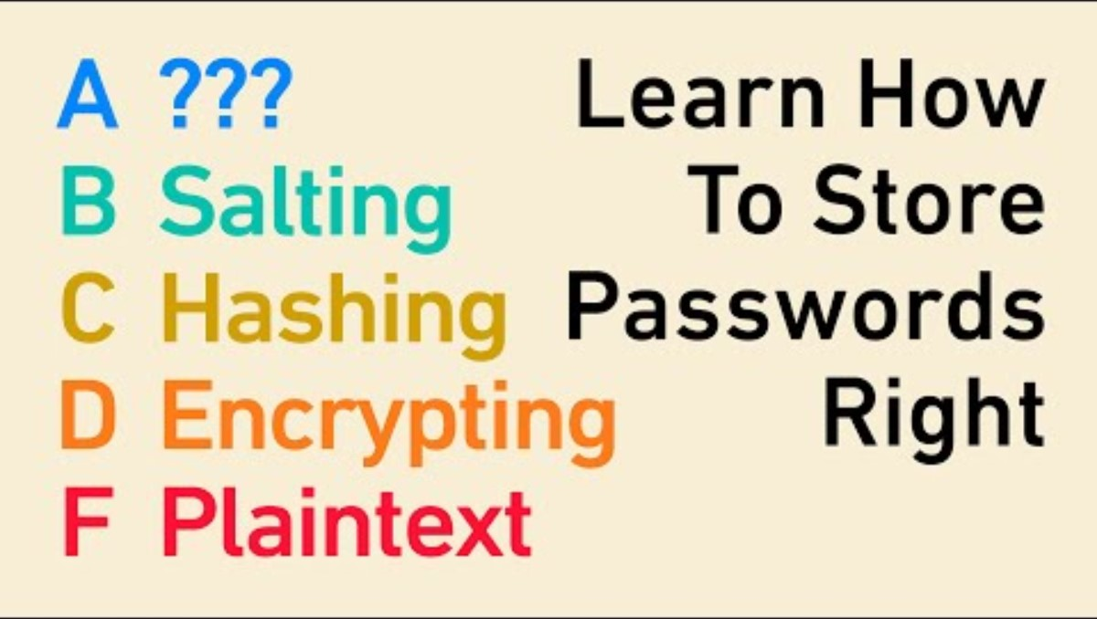

Slide 17
2.2 scrypt
scrypt, designed in 2009 by Colin Percival, introduced memory-hardness to password hashing.
Key Innovation: Memory-hard function. Requires storing large amounts of data in RAM during computation, preventing efficient GPU/ASIC implementation.

Slide 18
2.2 scrypt
Parameters:
N: CPU/memory cost parameter (typically 2^14 to 2^20)
r: Block size parameter
p: Parallelization parameter
Memory required: 128 * N * r bytes
Algorithm Overview:
Generate initial value using PBKDF2
Fill memory with sequential hash computations (ROMix)
Access memory in pseudorandom order (cannot be precomputed)
Extract final hash value

Slide 19
Example 2.2: scrypt Configuration
Conservative: N=2^14, r=8, p=1 -> 16 MB RAM, ~0.1s
Moderate: N=2^16, r=8, p=1 -> 64 MB RAM, ~0.4s
Aggressive: N=2^20, r=8, p=1 -> 1 GB RAM, ~5s

Slide 20
2.2 scrypt
Advantages:
Memory-hard: GPU/ASIC attacks expensive due to RAM requirements
Tunable parameters for different security/performance trade-offs
Used by cryptocurrencies (Litecoin) for proof-of-work
Limitations:
Complex to configure correctly
Less widely adopted than bcrypt
Vulnerable to cache-timing attacks in some implementations

Slide 21
2.3 Argon2
Argon2, winner of the 2015 Password Hashing Competition, represents the state-of-the-art in password hashing.
Variants:
Argon2d: Data-dependent (maximizes resistance to GPU cracking but vulnerable to side-channel attacks)
Argon2i: Data-independent (resistant to side-channel attacks but slightly weaker against GPU)
Argon2id: Hybrid (recommended for most applications—combines benefits of both)

Slide 22
2.3 Argon2
Parameters:
m: Memory cost in KB (typically 64 MB to 4 GB)
t: Time cost (number of iterations, typically 3-10)
p: Parallelism degree (number of threads, typically 1-4)
Algorithm Overview:
Argon2 fills memory with blocks derived from password and salt. It then processes memory with data-dependent (Argon2d) or data-independent (Argon2i) patterns. Multiple passes increase computational cost while maintaining memory requirements.

Slide 23
Example 2.3: Argon2id Configuration
OWASP Recommended: m=19456 (19 MB), t=2, p=1
High Security: m=65536 (64 MB), t=3, p=4
Maximum: m=4194304 (4 GB), t=10, p=1

Slide 24
2.3 Argon2
Advantages:
Winner of Password Hashing Competition (extensive cryptanalysis)
Memory-hard with tunable parameters
Three variants for different security models
Resistant to time-memory trade-offs
Excellent GPU/ASIC resistance
Current Status: Argon2id is the recommended choice for new applications. Industry consensus for password hashing as of 2020+.

Slide 25
2.4 Comparison and Recommendations
Function | Year | Memory-Hard | GPU Resistance | Status
bcrypt | 1999 | No | Moderate | Good
scrypt | 2009 | Yes | High | Good
Argon2 | 2015 | Yes | Excellent | Best

Slide 26
2.4 Comparison and Recommendations
Recommendations:
New Applications: Use Argon2id with OWASP recommended parameters
Existing bcrypt: If working well, no urgent need to migrate. Consider Argon2 for new passwords.
High-Security: Argon2id with increased memory (64+ MB)
Never Use: SHA-256, MD5, or any fast hash for passwords

Slide 27
3. Merkle Trees
3.1 Structure and Construction
3.2 Merkle Proofs
3.3 Applications

Slide 28
3. Merkle Trees
Merkle trees, invented by Ralph Merkle in 1979, provide efficient verification of data integrity for large datasets.

Slide 29
3.1 Structure and Construction
Definition 3.1 (Merkle Tree): A Merkle tree (or hash tree) is a binary tree where: (1) Each leaf node contains a hash of a data block, (2) Each internal node contains the hash of its children's concatenated hashes, (3) The root hash summarizes the entire dataset

Slide 30
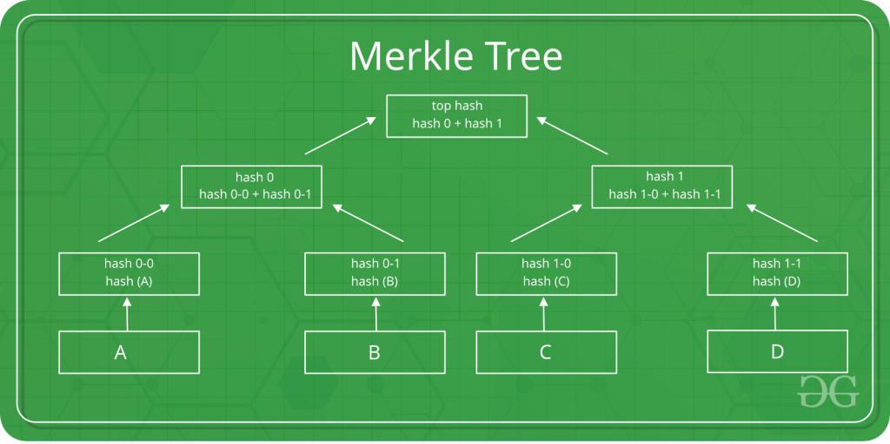

Slide 31
3.1 Structure and Construction
Construction Algorithm:
Divide data into n blocks D₀, D₁, ..., Dₙ₋₁
Compute leaf hashes: Hᵢ = H(Dᵢ)
If n is odd, duplicate last hash
Compute parent layer: H'ᵢ = H(H₂ᵢ || H₂ᵢ₊₁)
Repeat until single root hash remains

Slide 32
3.2 Merkle Proofs
The key advantage of Merkle trees is efficient membership proofs.
Definition 3.2 (Merkle Proof): A Merkle proof (or authentication path) for data block Dᵢ consists of the hashes of sibling nodes along the path from Dᵢ to the root. This allows verifying Dᵢ is in the tree without possessing all data.

Slide 33
Example 3.1: Merkle Proof
To prove D₁ is in tree with root R:
Proof = [H0, H23] // Sibling hashes along path
Verification: Compute H1 = H(D1), H01 = H(H0||H1), R' = H(H01||H23), Check R' = R

Slide 34
Example 3.1: Merkle Proof
Theorem 3.1: For a Merkle tree with n leaves, a membership proof requires O(log n) hashes and O(log n) hash computations to verify.
This logarithmic efficiency is why Merkle trees scale to billions of records.

Slide 35
3.3 Applications
Bitcoin and Blockchain: Each block contains Merkle tree of transactions. Root hash in block header. Light clients (SPV) verify transactions without downloading entire blockchain - only need block headers and Merkle proofs.

Slide 36
Example 3.2: Bitcoin Block
Block contains 2000 transactions = ~2 MB data
Block header contains only 32-byte Merkle root
To verify transaction: Download 80-byte header + log₂(2000) ≈ 11 hashes = ~432 bytes
Savings: 432 bytes vs 2 MB (>99.9% reduction)

Slide 37
3.3 Applications
Certificate Transparency: Public logs of SSL certificates use Merkle trees. Enables efficient auditing—can prove certificate was logged without downloading entire log.
Git Version Control: Git uses Merkle-like trees to efficiently track file changes. Each commit is identified by hash of tree structure.
Distributed Databases: Apache Cassandra, Amazon DynamoDB use Merkle trees for anti-entropy (detecting differences between database replicas).

Slide 38
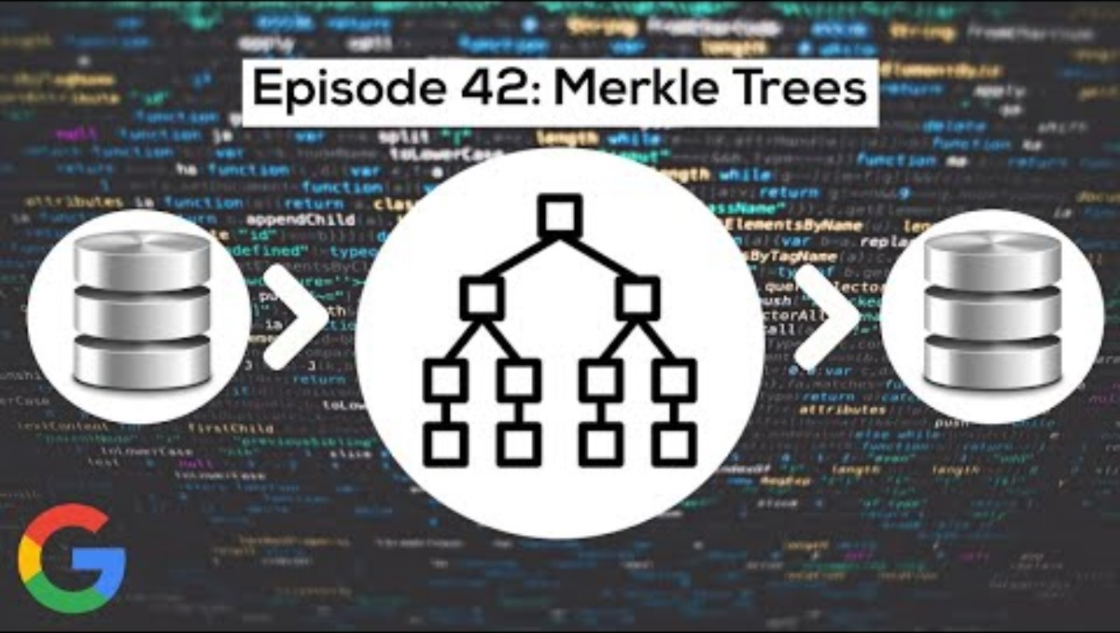

Slide 39
4. Hash Chains and Time-Stamping
4.1 Hash Chain Construction
4.2 Applications

Slide 40
4. Hash Chains and Time-Stamping
Hash chains link data elements sequentially, enabling verification of order and preventing backdating.

Slide 41
4.1 Hash Chain Construction
Definition 4.1 (Hash Chain): A hash chain is a sequence of values where each value is the hash of the previous value: h₀ = seed, hᵢ = H(hᵢ₋₁) for i > 0.
h₀ → h₁ = H(h₀) → h₂ = H(h₁) → h₃ = H(h₂) → ...
Property: Given hₙ, cannot compute hₙ₋₁ (one-way). Can verify chain by recomputing forward.

Slide 42
4.2 Applications
One-Time Passwords (S/KEY): Generate chain of length n. Use hₙ as first password, hₙ₋₁ as second, etc. Server stores current position. Compromise of transmitted password doesn't reveal future passwords.
Time-Stamping Services: Link document hashes in chronological order. Each entry includes previous hash plus timestamp, creating provable ordering.

Slide 43
Example 4.1: Document Time-Stamping
2024-01-01: Doc A, h₁ = H(doc_A || timestamp)
2024-01-02: Doc B, h₂ = H(doc_B || timestamp || h₁)
2024-01-03: Doc C, h₃ = H(doc_C || timestamp || h₂)
Cannot backdate Doc C because h₂ depends on h₁. Any modification breaks chain.
Blockchain: Bitcoin blockchain is essentially a hash chain where each block header includes hash of previous block. This creates immutable, ordered history.

Slide 44
5. Commitment Schemes
4.1 Hash Chain Construction
4.2 Applications

Slide 45
5. Commitment Schemes
Commitment schemes enable committing to a value without revealing it, with later verifiable revelation.

Slide 46
5.1 Definition and Properties
Definition 5.1 (Commitment Scheme): A commitment scheme has two phases: (1) Commit: Generate commitment c = Commit(value, r) using value and random nonce r. Publish c. (2) Open: Reveal (value, r). Anyone can verify c = Commit(value, r).
Required Properties:
Binding: After commitment, cannot find different (value', r') with same commitment. Formally: computationally infeasible to find value ≠ value' with Commit(value, r) = Commit(value', r').
Hiding: Commitment reveals no information about value. Formally: c is computationally indistinguishable from random.

Slide 47
5.2 Hash-Based Commitment
Commit(value, r) = H(value || r)
Open: Reveal (value, r), verify H(value || r) = c
Collision resistance ensures binding. Preimage resistance ensures hiding (assuming r has sufficient entropy).

Slide 48
Example 5.1: Coin Flip Protocol
Alice and Bob want to flip a coin remotely without trusting each other.
1. Alice chooses bit b ∈ {0,1}, random r, computes c = H(b || r)
2. Alice sends c to Bob
3. Bob chooses bit b' ∈ {0,1}, sends to Alice
4. Alice reveals (b, r)
5. Bob verifies c = H(b || r)
6. Result = b ⊕ b'
Security: Alice cannot change b after seeing b' (binding). Bob learns nothing about b until reveal (hiding). Result is unpredictable unless both collude.

Slide 49
5.3 Applications
Auctions: Sealed-bid auctions where bidders commit to bids, reveal simultaneously. Prevents bid manipulation.
Voting: Voters commit to votes, reveal after voting closes. Prevents vote buying and coercion.
Zero-Knowledge Proofs: Commitments enable proving knowledge without revealing information.
Smart Contracts: Ethereum commit-reveal patterns for fair on-chain randomness and games.

Slide 50
6. Hash-Based Signatures
6.1 Lamport One-Time Signatures
6.2 Merkle Signature Scheme
6.3 Modern Schemes: XMSS and SPHINCS+

Slide 51
6.3 Modern Schemes: XMSS and SPHINCS+
Hash-based signatures provide quantum-resistant digital signatures using only hash functions, not public-key cryptography.

Slide 52
6.1 Lamport One-Time Signatures
Lamport signatures, invented in 1979, are the simplest hash-based signature scheme.

Slide 53
6.1 Lamport One-Time Signatures
Key Generation (for 256-bit messages):
Generate 512 random 256-bit values: x₀,₀, x₀,₁, x₁,₀, x₁,₁, ..., x₂₅₅,₀, x₂₅₅,₁
Compute public key: y_{i,j} = H(x_{i,j}) for all i,j
Private key: all x_{i,j} values; Public key: all y_{i,j} values
Signing message M:
Compute h = H(M) = b₀b₁...b₂₅₅ (256 bits)
For each bit i, include x_{i,bᵢ} in signature
Signature consists of 256 values, one per bit of hash.

Slide 54
6.1 Lamport One-Time Signatures
Verification:
Compute h = H(M)
For each bit i, verify H(signature[i]) = y_{i,bᵢ}
Security: Forging signature requires finding preimage of hash—computationally infeasible.
Limitation: One-time signature. Signing two messages reveals both x_{i,0} and x_{i,1} for some bits, enabling forgery.

Slide 55
6.2 Merkle Signature Scheme
Merkle signatures combine Lamport signatures with Merkle trees to enable multiple signatures.

Slide 56
6.2 Merkle Signature Scheme
Construction:
Generate n Lamport key pairs
Build Merkle tree with public keys as leaves
Root hash becomes overall public key
Signing:
Use next unused Lamport key pair to sign message
Include Lamport signature + Merkle proof for that public key
This enables n signatures with single published public key (root hash).

Slide 57
6.3 Modern Schemes: XMSS and SPHINCS+
XMSS (eXtended Merkle Signature Scheme): Standardized by NIST (RFC 8391). Uses improved one-time signatures (WOTS+) and hierarchical Merkle trees. Efficient and practical.
SPHINCS+: Stateless hash-based signatures. No need to track which keys have been used. NIST post-quantum cryptography competition finalist. Larger signatures but eliminates state management.
Quantum Resistance: Hash-based signatures resist quantum computers because they rely only on hash function security, not hardness of factoring or discrete logarithm. Critical for post-quantum cryptography.

Slide 58
Conclusion
This lecture demonstrated the versatility of hash functions beyond simple data integrity. Key insights:
Password hashing requires specialized functions (Argon2id, bcrypt, scrypt)—never use fast hashes
Merkle trees enable efficient verification with logarithmic overhead—foundation of blockchain and distributed systems
Hash chains create verifiable ordering and prevent backdating
Commitment schemes enable fair protocols without trusted parties
Hash-based signatures provide quantum-resistant digital signatures

Slide 59
Looking Forward
Next Section (Weeks 9-11): Asymmetric Cryptography. We will study RSA, Diffie-Hellman key exchange, elliptic curve cryptography (ECC), digital signatures (ECDSA, EdDSA), and public key infrastructure (PKI).

Slide 60
Preparation
Read Ferguson et al., Chapter 10-11: Public Key Cryptography, RSA
Review: Number theory basics (modular arithmetic, primes, Euler's theorem)
Lab 2 Due: Implement Merkle tree, experiment with Argon2
Colloquium 2: Hash function applications and password security

Slide 61
References
Biryukov, A., Dinu, D., & Khovratovich, D. (2016). Argon2: the memory-hard function for password hashing and other applications.
Merkle, R. C. (1987). A digital signature based on a conventional encryption function. In Advances in Cryptology—CRYPTO '87.
Nakamoto, S. (2008). Bitcoin: A peer-to-peer electronic cash system.
Percival, C., & Josefsson, S. (2016). The scrypt password-based key derivation function (RFC 7914).
Provos, N., & Mazières, D. (1999). A future-adaptable password scheme. In Proceedings of USENIX Annual Technical Conference.

